Slide 1
LAPTOP PRICE PREDICTION
predicting laptop prices based on various factors such as specifications, brand reputation, and market demand using machine learning models

Slide 2
THE AGENDA OF A LAPTOP PRICE PREDICTION
Data Collection: Gather relevant data sources containing information about laptops, including specifications, brands, prices, and other relevant features.
Data Cleaning: Preprocess the collected data to handle missing values, outliers, and errors.
Exploratory Data Analysis (EDA): Visualize the data using graphs and charts to gain insights.
Feature Engineering: Create new features or transform existing ones to enhance the predictive power of the model. Like one-hot encoding, feature scaling

Slide 3
THE AGENDA OF A LAPTOP PRICE PREDICTION
Model Selection: Choose appropriate machine learning algorithms for the prediction task. Common models for regression tasks include linear regression, decision trees, random forests, and gradient boosting algorithms
Model Training: Split the dataset into training and testing sets, and train the selected models on the training data.
Model Evaluation: Evaluate the performance of trained models using appropriate evaluation metrics such as mean absolute error (MAE), mean squared error (MSE), or root mean squared error (RMSE).
Deployment: Deploy the trained model into a production environment where it can be used to make predictions on new, unseen data.

Slide 4
why we do the laptop price analysis?
Smart Decisions: Predicting laptop prices helps people make smarter decisions about buying, selling, and managing laptops.
Better Prices: It helps businesses set the right prices for laptops, ensuring they stay competitive and make more money.
Knowing the Competition: By predicting prices, businesses can understand what competitors are doing and stay ahead in the market.
Reducing Risks: Knowing future price trends helps businesses avoid losing money due to unexpected changes in the market.

Slide 5
DATASET
Company | TypeName | Inches | ScreenResolution | Cpu | Ram | Memory | Gpu | OpSys | Weight | Price
Apple | Ultrabook | 13.3 | IPS Panel Retina Display 2560x1600 | Intel Core i5 2.3GHz | 8GB | 128GB SSD | Intel Iris Plus Graphics 640 | macOS | 1.37kg | 71378.6832
Apple | Ultrabook | 13.3 | 1440x900 | Intel Core i5 1.8GHz | 8GB | 128GB Flash Storage | Intel HD Graphics 6000 | macOS | 1.34kg | 47895.5232
HP | Notebook | 15.6 | Full HD 1920x1080 | Intel Core i5 7200U 2.5GHz | 8GB | 256GB SSD | Intel HD Graphics 620 | No OS | 1.86kg | 30636
Apple | Ultrabook | 15.4 | IPS Panel Retina Display 2880x1800 | Intel Core i7 2.7GHz | 16GB | 512GB SSD | AMD Radeon Pro 455 | macOS | 1.83kg | 135195.336
Apple | Ultrabook | 13.3 | IPS Panel Retina Display 2560x1600 | Intel Core i5 3.1GHz | 8GB | 256GB SSD | Intel Iris Plus Graphics 650 | macOS | 1.37kg | 96095.808
Acer | Notebook | 15.6 | 1366x768 | AMD A9-Series 9420 3GHz | 4GB | 500GB HDD | AMD Radeon R5 | Windows 10 | 2.1kg | 21312
Apple | Ultrabook | 15.4 | IPS Panel Retina Display 2880x1800 | Intel Core i7 2.2GHz | 16GB | 256GB Flash Storage | Intel Iris Pro Graphics | Mac OS X | 2.04kg | 114017.6016
Apple | Ultrabook | 13.3 | 1440x900 | Intel Core i5 1.8GHz | 8GB | 256GB Flash Storage | Intel HD Graphics 6000 | macOS | 1.34kg | 61735.536
Asus | Ultrabook | 14 | Full HD 1920x1080 | Intel Core i7 8550U 1.8GHz | 16GB | 512GB SSD | Nvidia GeForce MX150 | Windows 10 | 1.3kg | 79653.6
Acer | Ultrabook | 14 | IPS Panel Full HD 1920x1080 | Intel Core i5 8250U 1.6GHz | 8GB | 256GB SSD | Intel UHD Graphics 620 | Windows 10 | 1.6kg | 41025.6
HP | Notebook | 15.6 | 1366x768 | Intel Core i5 7200U 2.5GHz | 4GB | 500GB HDD | Intel HD Graphics 620 | No OS | 1.86kg | 20986.992
DESCRIBE
 | Inches | Price
Min | 10.10 | 9,270.7200
Mean | 15.01 | 59,870.04
Max | 18.04 | 3,24,954.720
 | Inches | Price
25% | 14.00 | 31914.7200
50% | 15.60 | 52054.560
75% | 15.60 | 79274.246

Slide 6
This bar chart shows the distribution of laptop brands in the dataset, with Dell and Lenovo being the most prevalent brands, followed by HP and Asus.

Slide 7
This bar chart illustrates the distribution of laptop types in the dataset, with "Notebook" being the most common type, followed by "Gaming" laptops and "Ultabooks."

Slide 9
This data represents the distribution of RAM (Random Access Memory) sizes in the dataset. The majority of laptops have 8GB of RAM, followed by 4GB and 16GB, indicating that these are the most common configurations among the laptops in the dataset.

Slide 10
This distribution depicts the operating systems (OpSys) used by laptops in the dataset. Windows 10 is the most prevalent,

Slide 11
Features of laptop

Slide 12
Features of laptop
This slide overview of key features commonly found in laptops.Here feature Like: touchscreen, IPS panel, Full HD.
In this dataset, the analysis reveals that a significant majority of laptops are equipped with Full HD displayed Ultra HD, arranged for easy reference.

Slide 13
The dataset indicates that Intel Core i7 and i5 processors are the most common among laptops, followed by other Intel processors and a smaller proportion of AMD processors.

Slide 15
DATASET
Train
Test
Train Model
Evaluate Model

Slide 16
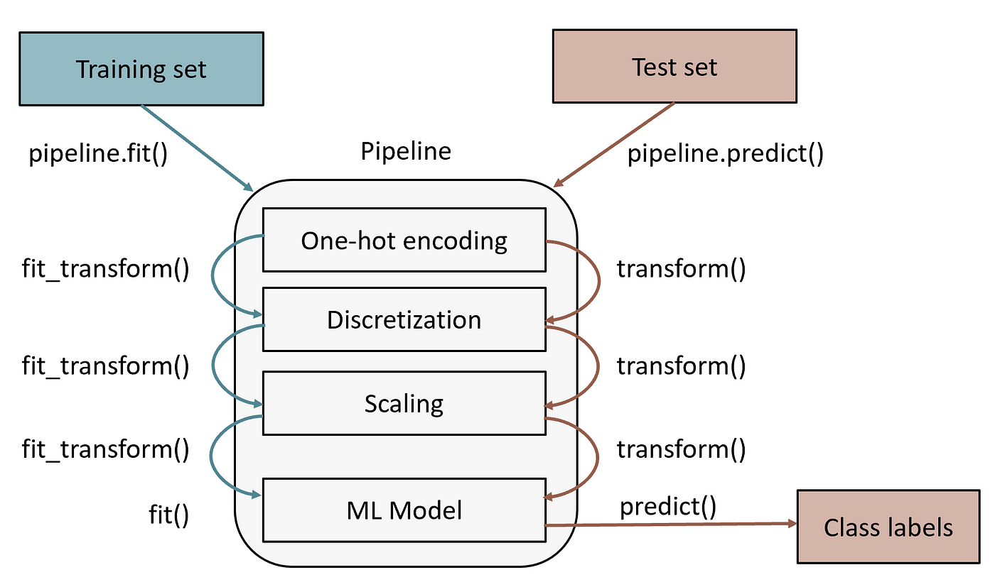

Slide 17
